Slide 1
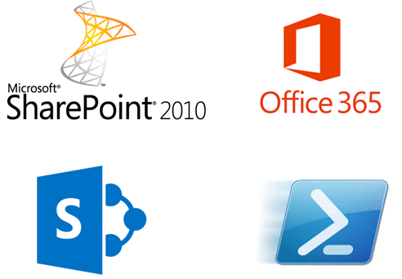
SharePoint as a Service Delivery Platform
Points to Consider
Slow moving processes
Political decisions
Scared of Change
This is how we have always done it!
Wariness of the unknown!
Its not broken so why fix it?

Slide 2
@ryanyates1990

Slide 3
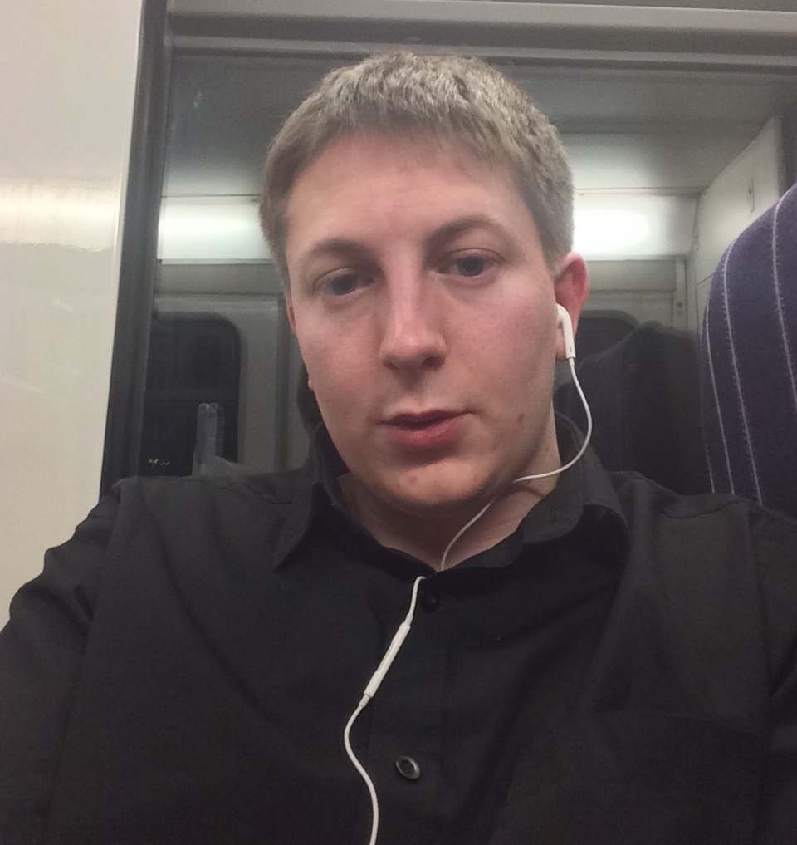
Who Am I?
Ryan Yates – 25 – Proud father to Aaron 5 & Kyra 15 months
Currently
MCP – Windows XP
Planned
MCSA Office 365
MCITP SharePoint 2010 & MCSE SharePoint 2013
MCSA Server 2008 -> Server 2012
MCSE Private Cloud

Slide 4
Tweet me
@ryanyates1990
Any Photos or Questions about this now or in future

Slide 5
Professional Background
Currently
SharePoint Applications/Implementation Analyst - University Of Manchester
Previously
SharePoint User Support Services Engineering Consultant – Barclays
Various Retail Jobs
Passion for all things IT related however predominantly been Microsoft Focused since Windows XP
SharePoint was my entry into IT
However PowerShell is my Secret love
“Spend less time doing the same mundane tasks and spend more time pushing your knowledge in automation”
Simple Task Automation = Early DevOps implementation

Slide 6
Background to this Session
Tasks that take 2 or 3 minutes to do can take 3-4 days to get authorised and then actioned
IT is ALWAYS the blocker – Whether it be People or Processes
Items of work get lost in 1 persons Inbox
No mitigation plans in place for holidays/sickness result in project delays
Business users will bypass IT processes so that the work gets done – Dropbox is a common example
How can we get round this issue?
How can we make things easier?
How can we ensure that we have a robust and scalable method for service delivery ?

Slide 7
Service Delivery 101
What is Service Delivery?
Service Delivery can be simplified into 3 streams
Standard Work Requests – New Accounts , Mailboxes, SharePoint Sites, Virtual Servers (std)
Bespoke Work Requests – Small Variations to the above
Projects – New functionality implementations – CRM, Project Server, In-house Applications
Why should we worry about not delivering within our own environment?
Imagine the inability to withdraw cash or that Credit\Debit cards no longer existed or Online Shopping Sites didn’t exist – How would you cope day to day? – That is how the business users will continue to view IT – Behind the times inefficient and the LAST resort
So what can we look to do to mitigate these Issues?

Slide 8
Round the Room Votes!
Company size – Under 100 FTE’s = ?? 100 to 200 FTE’s = ?? 200 to 500 FTE’s = ?? 500-1000 FTE’s = ?? 1000+ FTE’s = ??
Do you have SharePoint?? Yes = ?? % No = ?? %
If yes then is it – 2003 = ?? 2007 = ?? 2010 = ?? 2013 = ?? Online = ?? Not Sure = ??

Slide 9
DEMO
In this Demo we will show how we can use either an on-premises SharePoint Instance or a SharePoint Online instance to provide a simple user friendly form to enable user creation to be a more automated, and therefore streamlined process.

Slide 10
Any Questions??

Slide 11
Further Details
Twitter - @ryanyates1990
LinkedIn - http://uk.linkedin.com/in/ryanyates90
SUG Yammer network - https://www.yammer.com/sharepointusergroupukcommunity/
Blog – www.kilasuit.org/blog
Email/Lync – ryan.yates@kilasuit.org

